Slide 1
Arrays in JavaScript
Building modern websites

Slide 2
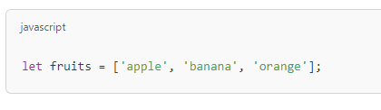
Arrays
In JavaScript, an array is a special type of object used to store multiple values in a single variable. Arrays are zero-indexed, meaning the first element is at index 0.

Slide 3
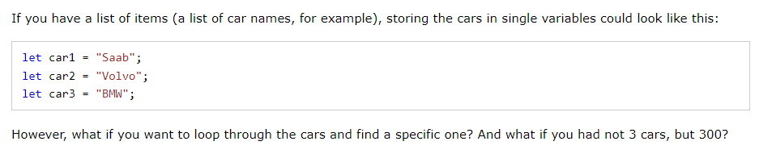
Why use Arrays?

Slide 4
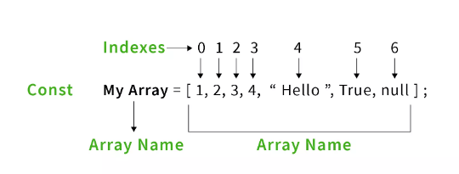
Creating an Array

Slide 5
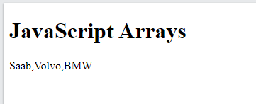
Example
<!DOCTYPE html>
<html>
<body>
<h1>JavaScript Arrays</h1>
<p id="demo"></p>
<script>
const cars = [
"Saab",
"Volvo",
"BMW"
];
document.getElementById("demo").innerHTML = cars;
</script>
</body>
</html>

Slide 6
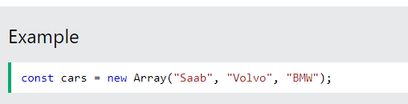
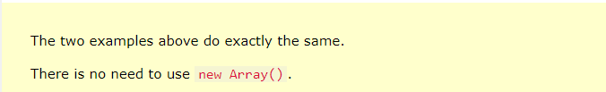
Using the JavaScript Keyword new
The following example also creates an Array, and assigns values to it:

Slide 7
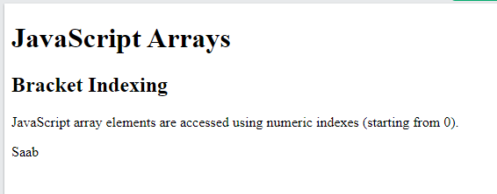
Accessing Array Elements
You access an array element by referring to the index number:
<!DOCTYPE html>
<html>
<body>
<h1>JavaScript Arrays</h1>
<h2>Bracket Indexing</h2>
<p>JavaScript array elements are accessed using numeric indexes (starting from 0).</p>
<p id="demo"></p>
<script>
Let cars = ["Saab", "Volvo", "BMW"];
document.getElementById("demo").innerHTML = cars[0];
</script>
</body>
</html>

Slide 8
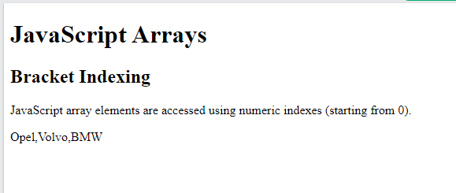
Changing Array Element
<!DOCTYPE html>
<html>
<body>
<h1>JavaScript Arrays</h1>
<h2>Bracket Indexing</h2>
<p>JavaScript array elements are accessed using numeric indexes (starting from 0).</p>
<p id="demo"></p>
<script>
const cars = ["Saab", "Volvo", "BMW"];
cars[0] = "Opel";
document.getElementById("demo").innerHTML = cars;
</script>
</body>
</html>

Slide 9
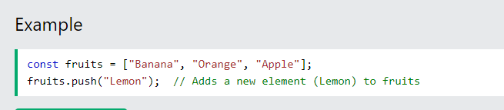
Adding Array Elements
The easiest way to add a new element to an array is using the push() method:
<!DOCTYPE html>
<html>
<body>
<h1>JavaScript Arrays</h1>
<h2>The push() Method</h2>
<p>The push method appends a new element to an array.</p>
<button onclick="fruits.push('Lemon');
document.getElementById('demo').innerHTML = fruits;">Try it</button>
<p id="demo"></p>
<script>
const fruits = ["Banana", "Orange", "Apple"];
document.getElementById("demo").innerHTML = fruits;
</script>
</body>
</html>

Slide 10
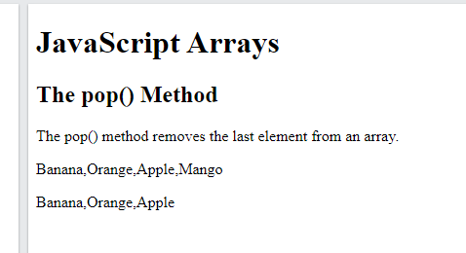
JavaScript Array pop()
The pop() method removes the last element from an array:
<!DOCTYPE html>
<html>
<body>
<h1>JavaScript Arrays</h1>
<h2>The pop() Method</h2>
<p>The pop() method removes the last element from an array.</p>
<p id="demo1"></p>
<p id="demo2"></p>
<script>
const fruits = ["Banana", "Orange", "Apple", "Mango"];
document.getElementById("demo1").innerHTML = fruits;
fruits.pop();
document.getElementById("demo2").innerHTML = fruits;
</script>
</body>
</html>
fruits.splice(2, 1)

Slide 11
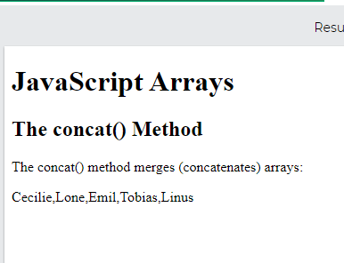
JavaScript Array concat()
The concat() method creates a new array by merging (concatenating) existing arrays:
<!DOCTYPE html>
<html>
<body>
<h1>JavaScript Arrays</h1>
<h2>The concat() Method</h2>
<p>The concat() method merges (concatenates) arrays:</p>
<p id="demo"></p>
<script>
const myGirls = ["Cecilie", "Lone"];
const myBoys = ["Emil", "Tobias", "Linus"];
const myChildren = myGirls.concat(myBoys);
document.getElementById("demo").innerHTML = myChildren;
</script>
</body>
</html>

